Slide 1
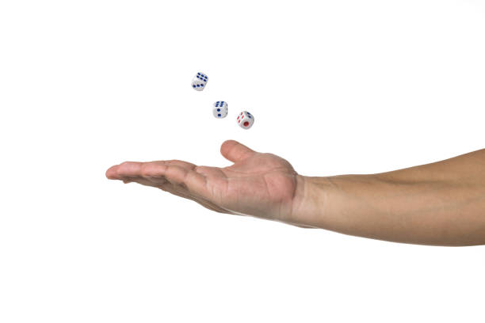
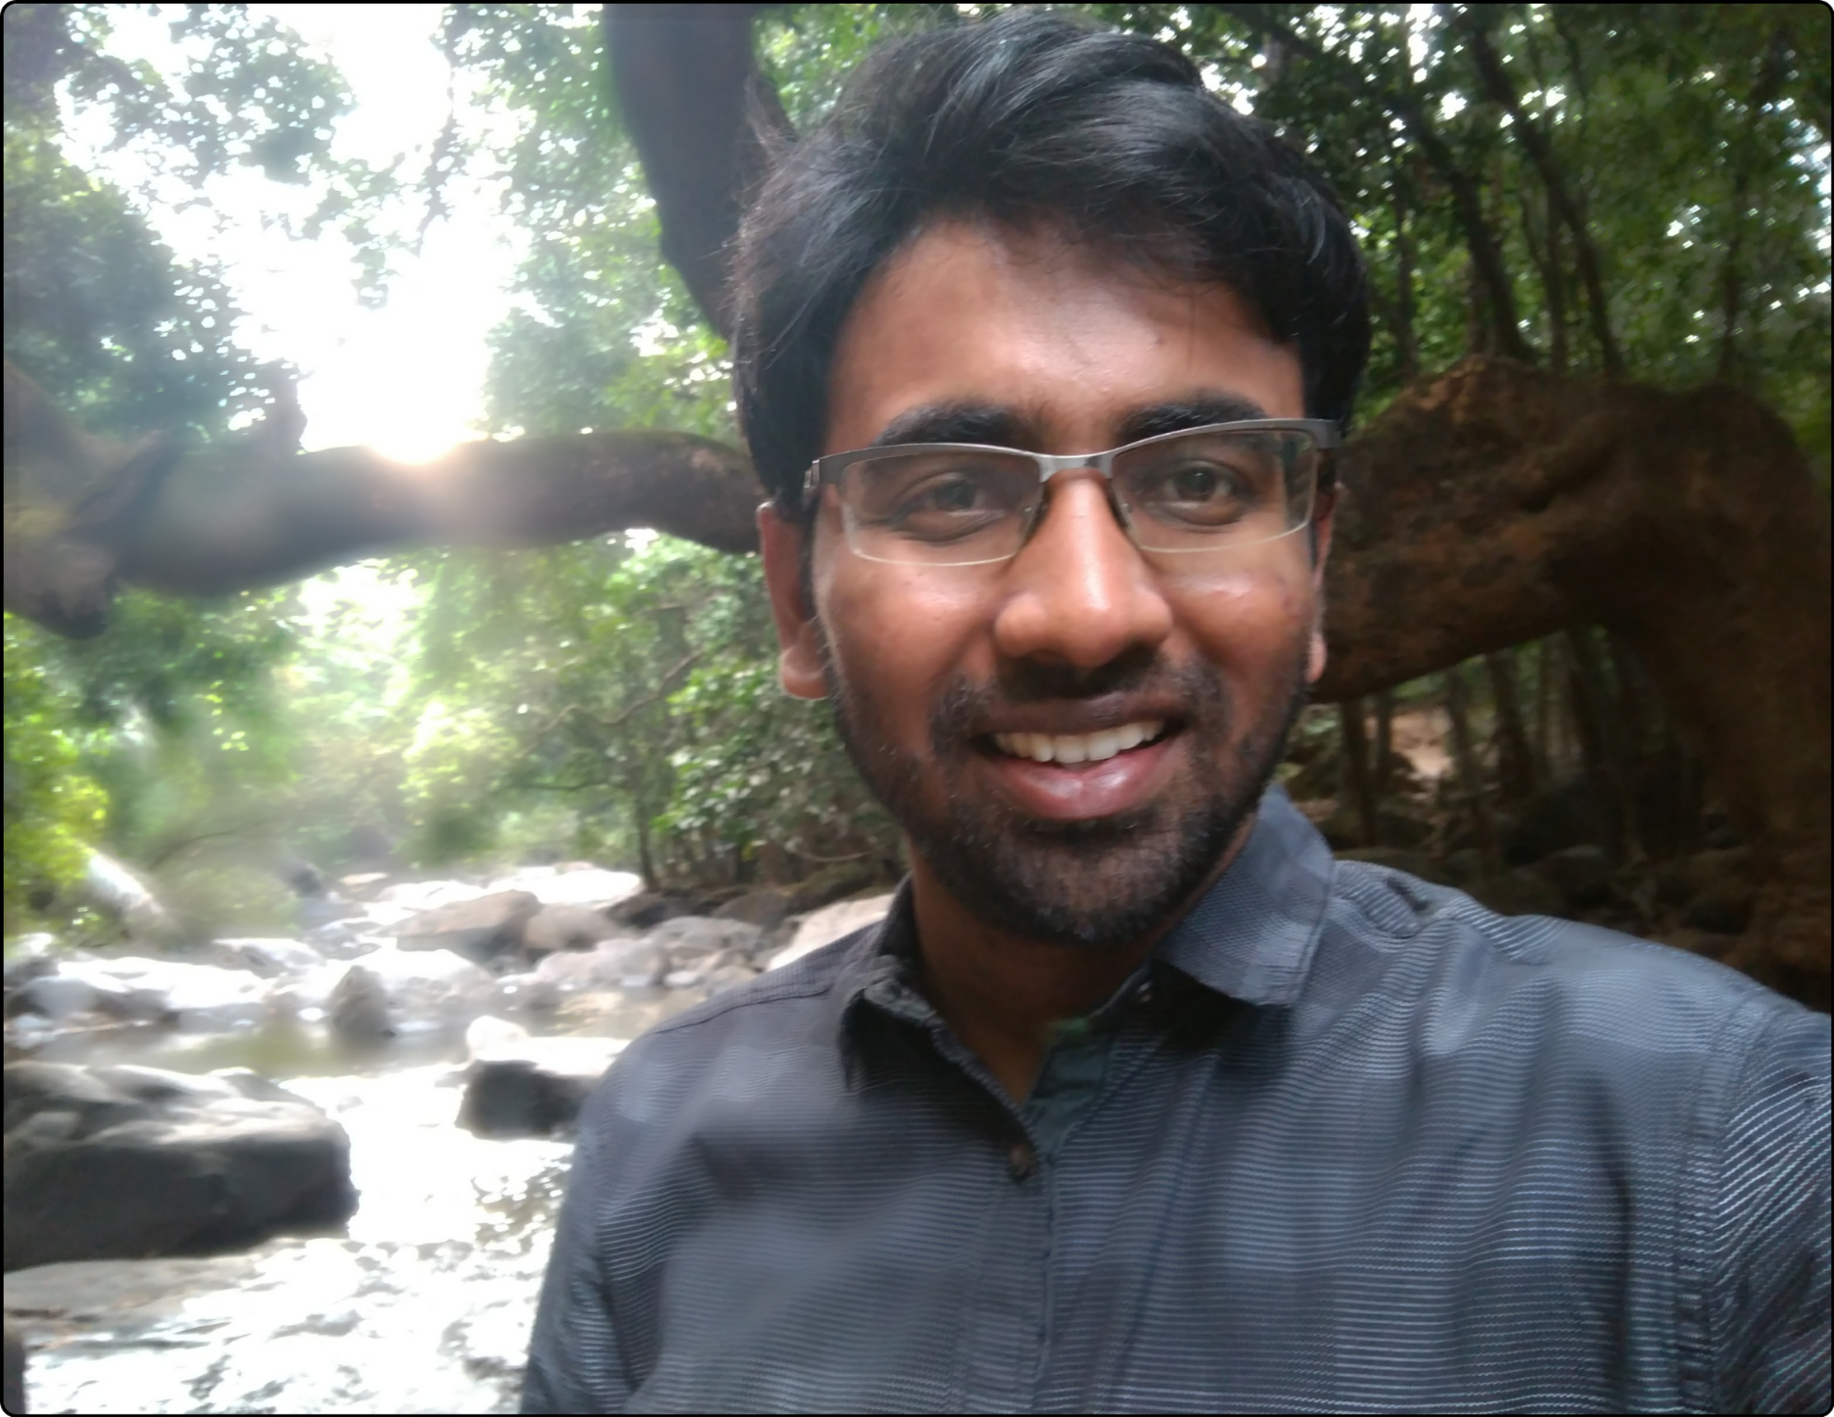
Probabilistic Karma
God does not play dice with the Universe
~ Einstein.
God may not play dice...
but WE DO
~ Arahant.
Arahant A
Computer Science
Courant Institute
New York University

Slide 2
The Idea...
is to debunk the age-old theory of Karma by proving that human actions & reactions are bound by probability, thus replacing it with a mathematical and computationally verifiable model for distribution of Human actions.
Using the Standard normal distribution and with a corroboration from History repeats itself, I posit that a person doesn't get what (s)he deserves, but what the probability allows.
Once an action is committed, its probability of repetition increases, which implies that more people, including the actor, are susceptible, or “destined”, to be recipients of a similar-natured action.
Common-natured actions are centred in the bell curve, as opposed to the rare-natured actions. So, any person will most likely be a committer and a recipient of those common-natured actions, irrespective of their deeds.

Slide 3
So far...
I've developed...
A Mathematical Theoretical model
A Computational model for Simulation to verify that the simulated pattern does indeed confirm my Theoretical model and reality
I'm currently...
Gathering common distribution patterns of human nature through Social experiments
And using this data in my simulation

Slide 4
Obstacles
What are the current distribution patterns of human nature, in terms of Benevolence, Indifference, Malevolence?
Different societies have different distribution patterns.
To find sources of quantified human nature distribution patterns
Great potential to study Human history from a Mathematical perspective
Predict the probabilistic paths of humanity
The dawn of integration between Mathematics and Philosophy
Opportunities

Slide 5
Next steps...
Exploring relevant social experiments which reveal distribution patterns of human nature in a community
Extract these patterns
Feed this pattern data into the simulation model
All of this by the end of Summer

